Slide 1
Cryptography and Computer Security (CSS) Lecture # 8

Slide 2
Introduction to CSS Course (CS401)

Slide 3
Unit III Cryptographic Hash Functions
Cryptographic Hash Functions
Applications
Simple hash functions
Requirements and security
Hash functions based on Cipher Block Chaining
Secure Hash Algorithm (SHA)

Slide 4
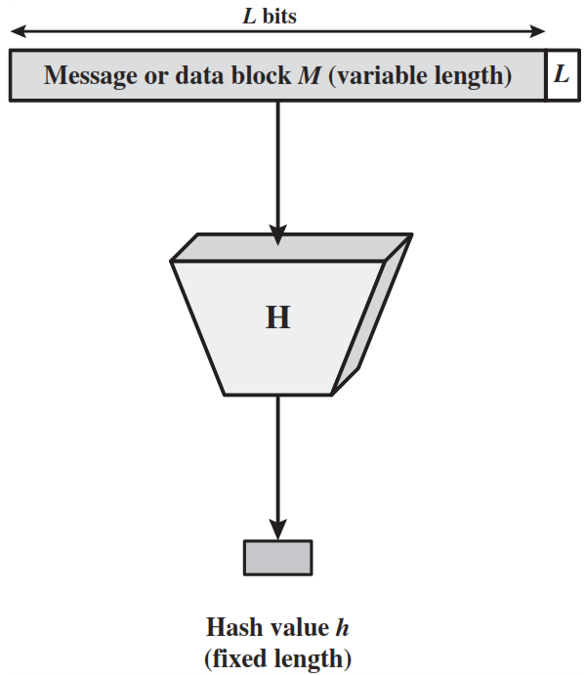
Hash Function
A hash function H accepts a variable-length block of data M as input and produces a fixed-size hash value h = H(M).
A “good” hash function has the property that the results of applying a change to any bit or bits in M results, with high probability, in a change to the hash code.

Slide 5
Applications of Cryptographic Hash Functions
Message authentication
Digital Signature
One-way password file

Slide 6
1. Message Authentication
Message authentication is a mechanism or service used to verify the integrity of a message.
Message authentication assures that data received are exactly as sent (i.e., contain no modification, insertion, deletion, or replay).
When a hash function is used to provide message authentication, the hash function value is often referred to as a message digest.

Slide 7
Message authentication method - 1
Source A
Destination B
M
M
H
ll
E
D
Compare
K
K
H
H(M)
E (K, [ M || H(M)])
Only A and B share the secret key, the message must have come from A and has not been altered.
The hash code provides the structure required to achieve authentication.
Because encryption is applied to the entire message plus hash code, confidentiality is also provided.

Slide 8
Message authentication method - 2
Source A
Destination B
M
M
H
ll
K
K
Compare
H
E
D
E(K, H(M))
Only the hash code is encrypted, using symmetric encryption.
This reduces the processing burden for those applications that do not require confidentiality.

Slide 9
Message authentication method - 3
Source A
Destination B
M
M
S
ll
H
ll
Compare
S
ll
H
H(M || S)
It is possible to use a hash function but no encryption for message authentication.
A and B share a common secret value S.
A computes the hash value over the concatenation of M and S and appends the resulting hash value to M.
Because B possesses S, it can recompute the hash value to verify.
An opponent cannot modify an intercepted message.

Slide 10
Message authentication method - 4
Source A
Destination B
M
M
S
ll
H
ll
E
D
Compare
K
K
S
ll
H
H(M || S)
E (K, [ M || H(M || S)])
Confidentiality can be added to the approach of method (3) by encrypting the entire message plus the hash code.

Slide 11
MAC (Message Authentication Code)
More commonly, message authentication is achieved using a MAC also known as keyed hash function.
MACs are used between two parties that share a secret key to authenticate information exchanged between those parties.
A MAC function takes as input a secret key and a data block and produces a hash value, referred to as the MAC.
The combination of hashing and encryption results in an overall function that is, in fact, a MAC (Method -2 in previous slide).

Slide 12
Digital Signature
A digital signature is a mathematical technique used to validate the authenticity and integrity of a message, software or digital document.
The operation of the digital signature is similar to that of the MAC.
In the case of the digital signature, the hash value of a message is encrypted with a user’s private key.
Anyone who knows the user’s public key can verify the integrity of the message that is associated with the digital signature.

Slide 13
Digital Signature method - 1
Source A
Destination B
M
M
H
ll
PRa
PUa
Compare
H
E
D
E(PRa, H(M))
The hash code is encrypted, using the sender’s private key and decrypted using sender’s public key.
This provides authentication.
It also provides a digital signature, because only the sender could have produced the encrypted hash code.

Slide 14
Digital Signature method - 2
Source A
Destination B
M
M
H
PRa
ll
E
D
PUa
Compare
K
K
H
E
D
E(Pra, H(M))
E (K, [ M || E(Pra, H(M)])
If confidentiality as well as a digital signature is desired, then the message plus the private-key-encrypted hash code can be encrypted using a symmetric secret key.

Slide 15
Security Requirements
Disclosure
Traffic analysis
Masquerade
Content modification
Sequence modification
Timing modification
Source repudiation
Destination repudiation

Slide 16
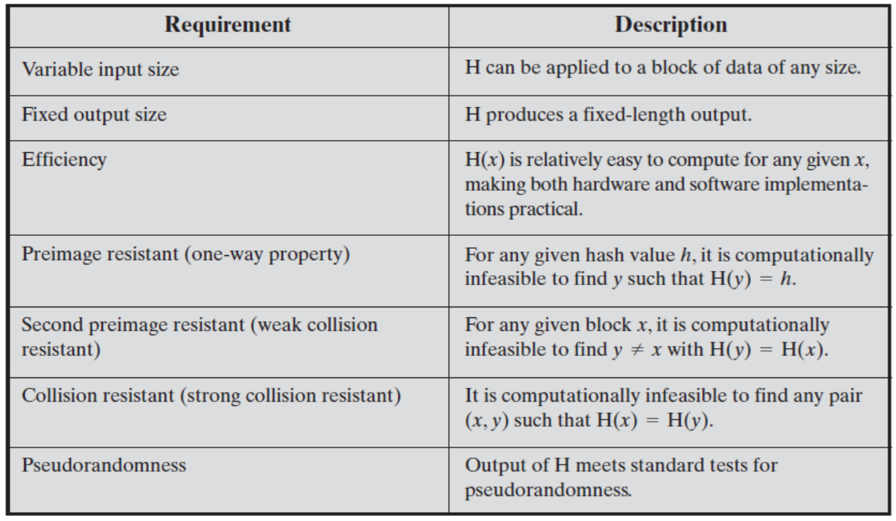
Properties Required for Cryptographic Hash Functions

Slide 17
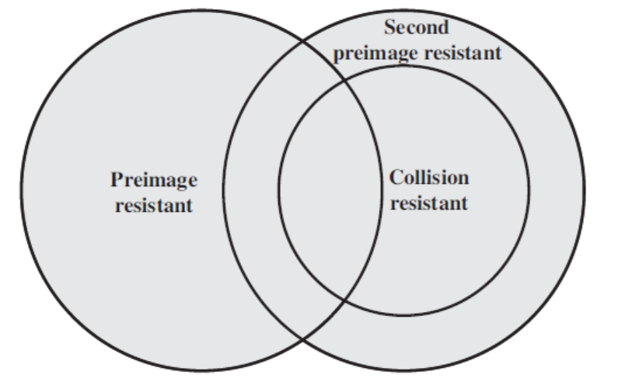
Properties Required for Cryptographic Hash Functions

Slide 18
Requirements for hash functions
Can be applied to any sized message M.
Produces fixed-length output h.
It is easy to compute h=H(M) for any message M.
Given hash value h is infeasible to find y such that (H(y) = h)
One-way property
For given block x, it is computational infeasible to find
y ≠ x with H(y) = H(x)
Weak collision resistance
It is computationally infeasible to find messages m1 and m2 with H(m1) = H(m2)
Strong collision resistance

Slide 19
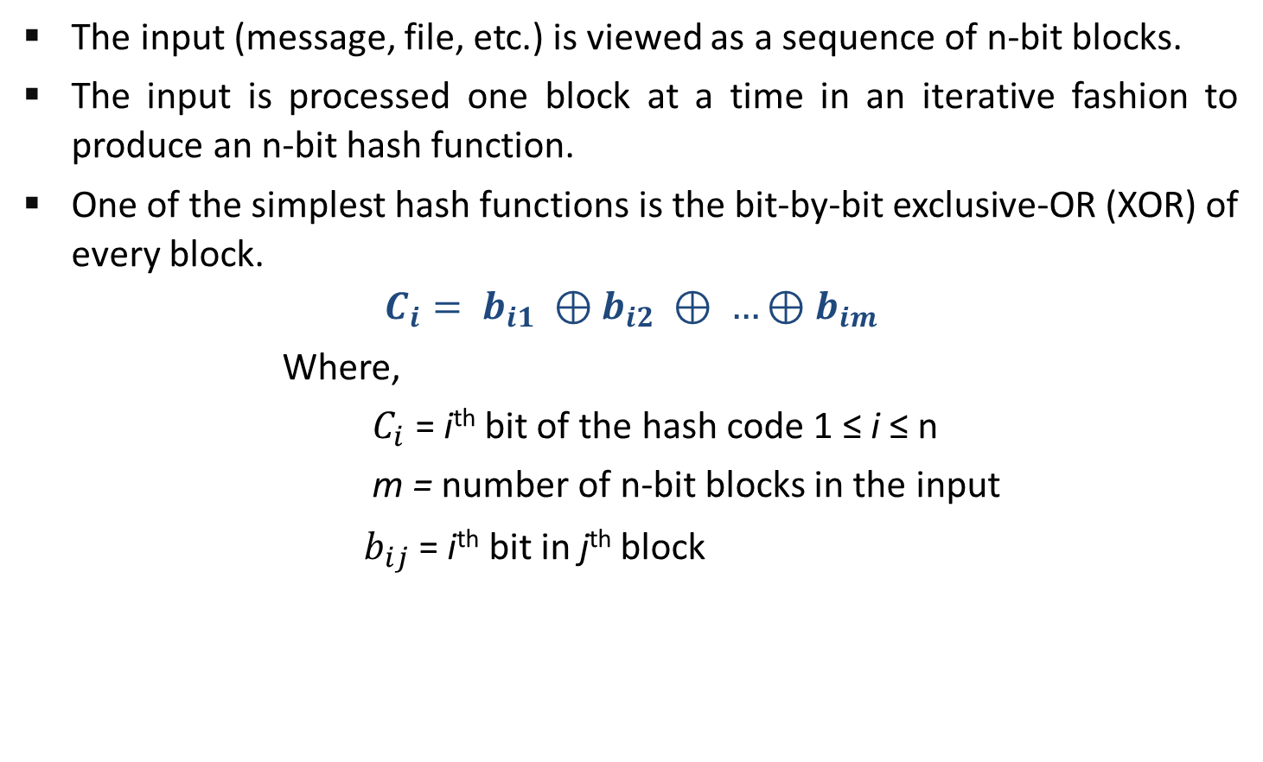
Simple Hash Function
The input (message, file, etc.) is viewed as a sequence of n-bit blocks.
The input is processed one block at a time in an iterative fashion to produce an n-bit hash function.
One of the simplest hash functions is the bit-by-bit exclusive-OR (XOR) of every block.
$$C_{i}= b_{i1} ⊕b_{i2} ⊕ …⊕b_{im}$$
Where,
$C_{i}$ = i^{th} bit of the hash code 1 ≤ i ≤ n
m = number of n-bit blocks in the input
$b_{ij}$ = i^{th} bit in j^{th} block

Slide 20
SHA - Secure Hash Algorithm
 | SHA - 1 | SHA - 224 | SHA - 256 | SHA - 384 | SHA - 512
Message Digest Size | 160 | 224 | 256 | 384 | 512
Message Size | < 2⁶⁴ | < 2⁶⁴ | < 2⁶⁴ | < 2¹²⁸ | < 2¹²⁸
Block Size | 512 | 512 | 512 | 1024 | 1024
Word Size | 32 | 32 | 32 | 64 | 64
Number of Steps | 80 | 64 | 64 | 80 | 80

Slide 21
SHA - 512
The algorithm takes as input a message with a maximum length of less than 2¹²⁸ bits and produces as output a 512-bit message digest.
The input is processed in 1024-bit blocks.

Slide 22
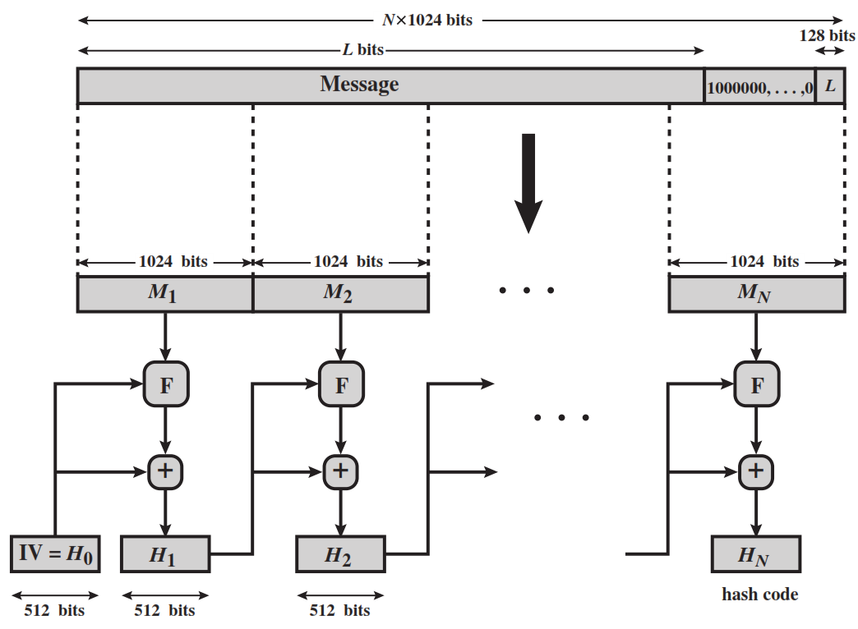
Message Digest Generation using SHA -512

Slide 23
Message Digest Generation using SHA -512
Message (L bit)
10000…0
L
M1 (1024 bits)
M2 (1024 bits)
MN (1024 bits)
F
F
F
+
+
+
IV=H0
H1 (512 bits)
H2 (512 bits)
HN (512 bits)

Slide 24
Step -1 Append Padding Bits
The message is padded so that its length is congruent to 896 modulo 1024 [length ≡ 896(mod 1024)] .
Padding is always added, even if the message is already of the desired length.
Thus, the number of padding bits is in the range of 1 to 1024.
The padding consists of a single 1 bit followed by the necessary number of 0 bits.

Slide 25
Step -2 Append Length
A block of 128 bits is appended to the message.
This block is treated as an unsigned 128-bit integer (most significant byte first) and contains the length of the original message (before the padding).

Slide 26
Step -3 Initialize hash buffer
The outcome of the first two steps produces a message that is an integer multiple of 1024 bits in length.
the expanded message is represented as the sequence of 1024-bit blocks M₁ , M₂, … , M_{N}, so that the total length of expanded message is N X 1024 bits.
A 512-bit buffer is used to hold intermediate and final results of the hash function. The buffer can be represented as eight 64-bit registers (a, b, c, d, e, f, g, h).

Slide 27
Step -4 Process message in 1024-bit (128-word) blocks
The heart of the algorithm is a module that consists of 80 rounds; this module is labelled F

Slide 28
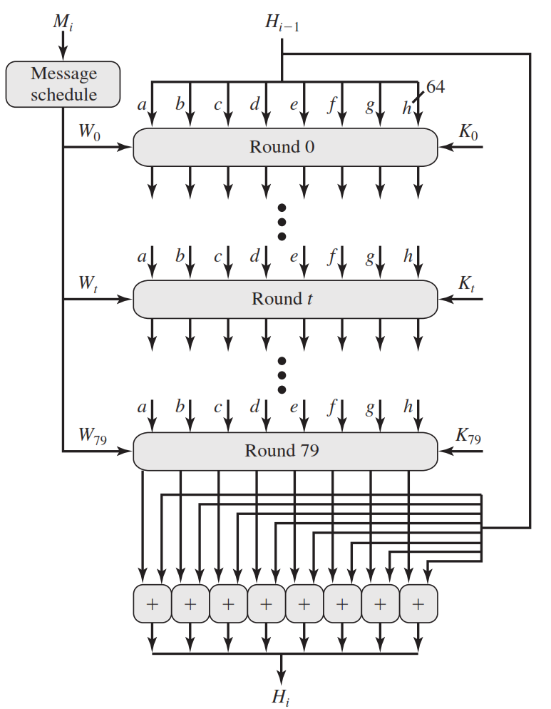
SHA-512 Processing of a Single 1024-Bit Block

Slide 29
SHA-512 Processing of a Single 1024-Bit Block
Mi
Hi-1
Message schedule
a
b
c
d
e
f
g
e
64
W0
K0
Round 0
a
b
c
d
e
f
g
e
64
W79
K79
Round 79
+
+
+
+
+
+
+
+
Hi

Slide 30
SHA-512 Processing of a Single 1024-Bit Block
Each round takes as input the 512-bit buffer value, abcdefgh, and updates the contents of the buffer.
At input to the first round, the buffer has the value of the intermediate hash value, H_{i-1}.
Each round t makes use of a 64-bit value Wt, derived from the current 1024-bit block being processed.
The output of the eightieth round is added to the input to the first round (H_{i}-1) to produce H_{i}.

Slide 31
Step – 5 Output
After all N 1024-bit blocks have been processed, the output from the Nth stage is the 512-bit message digest

Slide 32
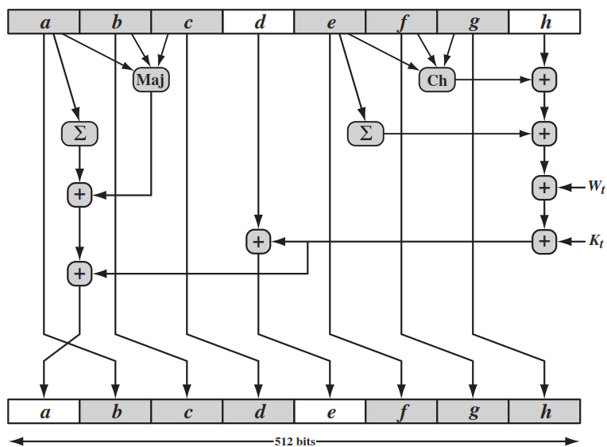
SHA-512 Round Function

Slide 33
SHA-512 Round Function – Cont…
a
b
c
d
e
f
g
h
Ch
+
Ʃ
Maj
+
Ʃ
+
+
+
+
Wt
+
Kt
a
b
c
d
e
f
g
h

Slide 34
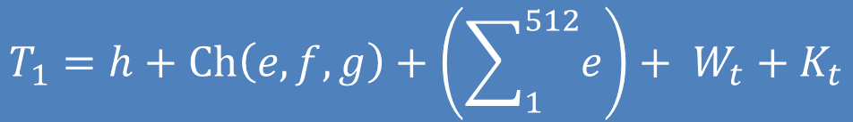
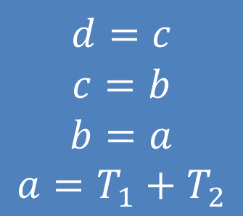
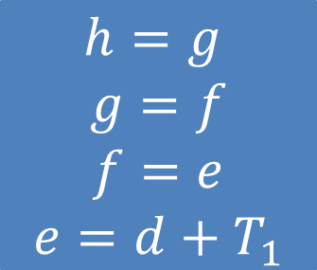
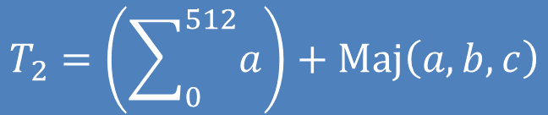
$$h=g$$
$$g=f$$
$$f=e$$
$$e=d+T_{1}$$
$$d=c$$
$$c=b$$
$$b=a$$
$$a=T_{1}+T_{2}$$
$$T_{1}=h+Ch\left(e,f,g\right)+\left(\sum_{1}^{512}{e}\right)+ W_{t}+K_{t}$$
$$T_{2}=\left(\sum_{0}^{512}{a}\right)+Maj\left(a,b,c\right)$$

Slide 35
SHA-512 Round Function Elements
Maj(a,b,c) = (a AND b) XOR (a AND c) XOR (b AND c) Majority of arguments are true
∑(a) = ROTR(a,28) XOR ROTR(a,34) XOR ROTR(a,39)
∑(e) = ROTR(e,14) XOR ROTR(e,18) XOR ROTR(e,41)
+ = addition modulo 2⁶⁴
K_{t} = a 64-bit additive constant
W_{t} = a 64-bit word derived from the current 512-bit input block.

